Slide 1
Lesson six Survey of the Old Testament Part 4: Babylon to Bethlehem
Mountjoy bible school
Weymouth class of 2019

Slide 2
From Babylon to Bethlehem
In our previous lessons we travelled along the timeline of the Old Testament from Creation to Canaan and then from Canaan to Babylon
In the history section this took us to the end of Second Kings and in the Prophetic section this took us to the end of Zephaniah.
In our study in the prophets we also looked at the post exile prophets, Haggai, Zechariah and Malachi

Slide 3
From Babylon to Bethlehem
We are now going to look at the last of the history books including First and Second Chronicles.
In timeline terms The Chronicles cover the same period as the books of Kings but they were compiled post-exile and are indeed the last books of the Jewish canon
The history books of the exile and return are Ezra, Nehemiah and Esther

Slide 4
From Babylon to Bethlehem
When we studied the first part of the Old Testament we noted that the record had large gaps in the timeline
Then we noted from Exodus to the end of Esther we have a complete timeline
We now have another significant gap in the timeline from the end of Nehemiah and the prophet Malachi to Matthew’s Gospel just over 400 years

Slide 5
From Babylon to Bethlehem
This time, however we have historical sources from the Apocryphal literature, the Jewish historian, Josephus and secular history
If we are Bible students, why should we wish to fill in the gaps in the historical timeline?
The answer to that question is simply that it will greatly assist in our understanding of the New Testament

Slide 6
From Babylon to Bethlehem
Imagine for a moment that you are reading your Bible as a history and you turn the page from Malachi (or Chronicles in the Jewish Bible) to Matthew.
Suddenly and dramatically you are faced with authorities, including kings, religious sects, ruling councils, educational systems, customs which are all new from the point of view of the Old Testament

Slide 7
From Babylon to Bethlehem
As well as these dramatic changes on the surface there are other differences that we need to be aware of.
The nation is different, it is now tiny in comparison
The spoken language is different, no longer Hebrew but Aramaic
There is a second language for educated people, Greek

Slide 8
From Babylon to Bethlehem
So when you open Matthew and you meet, Scribes, Pharisees, Sadducees, Chief priests and elders, Herodians, Zealots, King Herod, Caesar Augustus or a Roman governor;
You are entitled to ask, ‘Where did all these players appear from?
Or indeed when was Judah replaced with Galilee, Samaria and Judea?

Slide 9
From Babylon to Bethlehem
As part of a vast empire with a vassal king (Herod) what part was played by the Jewish Sanhedrin in the government of the country and when did they first appear?
Latin is the language of the Empire so why do the educated people speak Greek?
The Old Testament Scriptures were written in Hebrew but the people spoke Aramaic. Who translated for them?

Slide 10
From Babylon to Bethlehem
Jesus spoke Aramaic
Talitha cumi meaning “Little girl, get up!” (Mark 5:41)
Abba meaning “Father” (Mark 14:36)
Raca meaning “fool” (Matthew 5:22)
Rabbouni meaning “teacher” (John 20:16)
Eli lama sabachthani meaning “My God, my God, why have you forsaken me?” (Matthew 27:46)

Slide 11
From Babylon to Bethlehem
New institutions have now appeared.
Every small town on the provinces has a Synagogue. What goes on there? When were they established? They weren’t in the Old Testament.
Is this where the translation from Hebrew scriptures to Aramaic is done?
Let us complete the biblical history and consider the hidden history

Slide 12
History Timeline from Babylon to Bethlehem
Prophets of the Exile
Prophets of the Remnant
EZEKIEL
DANIEL
HAGGAI
ZECHARIAH
MALACHI
JOHN THE BAPTIST
PROPHETIC SILENCE
EXILE TO ASSYRIA
725 BC
2 KINGS
EXILE
1CHRONICLES
2CHRONICLES
EZRA
NEHEMIAH
ESTHER
PERSIAN RULE
ALEXANDRIAN
EGYPT RULE
SYRIA RULE
MACCABEAN REVOLT
ROMAN RULE
JULIUS CAESAR
HEROD THE GREAT
The birth of Yeshua Hamashiach
Jesus the Christ
590 BC
536 BC
GREEK RULE
ROMAN RULE
EXILE TO BABYLON
A REMNANT RETURNS
Judea ruled by the Persian Empire 536 BC – 330 BC
Judea ruled by the Alexandrian Empire: 330 BC — 308 BC
Judea ruled by Egypt: 308 BC — 195 BC
Judea ruled by Syria: 195 BC — 130 BC
Maccabean Revolt: 164 BC — 63 BC
Judea ruled by the Roman Empire: 65 BC — AD 70
From Republic to Empire Julius Caesar: 46 BC — 44 BC
Herod the Great reigns as King of the Jews: 37 BC — 4 BC
Notes:
GENESIS EXODUS LEVITICUS NUMBERS DEUTERONOMY JOSHUA JUDGES RUTH 1 SAMUEL 2 SAMUEL 1 KINGS 2 KINGS 1 CHRONICLES EZRA NEHEMIAH ESTHER JOB PSALMS PROVERBS ECCLESIASTES SONG OF SOLOMON’S SONG ISAIAH JEREMIAH LAMENTATIONS EZEKIEL DANIEL JOEL AMOS OBADIAH JONAH MICAH NAHUM HABAKKUK ZEPNANIAH HAGGAI ZECHARIAH MALACHI

Slide 13
First & Second Chronicles
History of the kingdom from the point of view of the priest
The Prophet is interested in the people of God
The Priest is interested in the house of God
A Prophet can minister anywhere (even in the northern kingdom)
A Priest can only operate in the sanctuary
Therefore Chronicles is only interested in the southern kingdom.

Slide 14
First & Second Chronicles
Note what is missing from Chronicles
History of Samuel & the reign of Saul (only his death - because it gave way to David)
Elijah & Elisha are omitted (because they ministered in the northern kingdom)
Chronicles is only interested in the sanctuary and David’s line because he wanted to build the Temple

Slide 15
First Chronicles
Begins with Adam and ends with the death of David, because David was the architect of the Temple project.
Filled with chronologies. This is Israel’s Somerset House
They are important in Chronicles because the Levites and the priests had to prove their ancestry before they could minister.
Also from the priests’ view the living links were pointers to the Messiah. If the chain had been broken (for example at the hand of Athaliah 2 Kings 8) then there would have been no Messiah

Slide 16
Second Chronicles
Begins with the building of the Temple
Ends with the burning of the Temple
When the temple was burned the heart of God was touched. Read the book of Lamentations in this respect.
They demonstrate one of God’s chief goals in history – the house of God

Slide 17
Ezra, Nehemiah & Esther
The main emphasis at the beginning of the twelve historical books was the entering of the land.
However, by the end of the monarchy the main bulk of the population had been exiled, so the books of Ezra & Nehemiah are going to deal with the matter of getting the ‘seed’ of Abraham back into the ‘land’.
Esther, on the other hand, is dealing with the preservation of the ‘seed’ while exiled.

Slide 18
The timeline of Ezra, Nehemiah, Esther
606 BC: Babylon invades and begins the deportation.
587 BC: Jerusalem falls to the enemy
539 BC: Babylon Falls to Cyrus the Persian king.
538 BC: Zerubabbel returns with a remnant of 50,000
535 BC: The Jews begin to rebuild the temple.
520 BC: After fifteen years, the work begins again
515 BC: The temple is completed and dedicated
476 BC: Esther becomes Queen of Persia
458 BC: Ezra travels to Jerusalem (see Ezra 7–10)
445 BC: Nehemiah prepares to return to Jerusalem

Slide 19
Ezra, Nehemiah & Esther
In 536, Zerubbabel and Joshua had taken about 50,000 Jews back and eventually rebuilt the temple, this starts in Ezra chapter 3 and is completed by the end of chapter 6.
In 457 there had been a small revival under Ezra chapters 7 to 10, but now it was 445, and God was looking for someone to go to the ruined city and restore safety and order.
Nehemiah was to be that person. Nehemiah had two objectives, first the repairing of the walls of the city, and secondly the reviving of the people which he furthered in co-operation with Ezra.

Slide 20
Ezra, Nehemiah & Esther
The events recorded in Esther take place between Ezra 6 and 7.
The ‘third year of Ahasuerus’ (1:3) would be 483 BC ‘Ahasuerus’ is the title of the Persian ruler, just as Pharaoh was the title of the Egyptian ruler.
Esther nowhere mentions the name of God. But although Jehovah’s name is not mentioned, His overruling providence is seen in every chapter of the book.

Slide 21
Ezra, Nehemiah & Esther
When we studied the minor prophets of the post-exile period we noted the Lord’s three great objectives, now we can compare them in the post-exile history books
Ezra - the house of God (cf. Chronicles)
Nehemiah - the city of God
Esther - the people of god
Haggai - the house of God
Zechariah - the house and city of God
Malachi - the people of God

Slide 22
The Intertestamental Period
Malachi closes around 400 BC
In 538 BC, under the authority of Cyrus, Zerubabbel and the 50,000 returnees go back to the land.
Ezra returns some 80 years later (458 BC) with a further 2000 returnees.
And Nehemiah returns 12 years later (445 BC)
All this is under the approval of the various kings of the Media-Persian Empire

Slide 23
The Intertestamental Period
Our Old Testament closes with a tiny proportion of the chosen people of God back in their land
The situation could not have been more bleak from a national point of view
Around 2 million had entered the land (600,000 men of military age)
They had been removed from the land by Assyria and Babylon

Slide 24
The Intertestamental Period
Now Media-Persia rules over both Babylon and Assyria
The rulers are kindly disposed to the People of Israel and allow a return but only of 50,000
Nor is it a return to independence, they are still subject of the Persian Empire and will remain so for 200 years until the rise of a new world power

Slide 25
The Remnant and the Empires of the world
Tremendous changes take place in the life of the nation before the opening of the New Testament and they are forged in the tumult of the rise and fall of world empires
All of this was seen exactly by Daniel as he served in the courts of the Babylonian and then Persian kings
In the visions seen, or interpreted, recorded in Daniel chapters 2, 7 and 8, five great empires are identified some of them with sub-divisions.

Slide 26
The Remnant and the Empires of the world
Babylon, Media-Persian, Greek (and the subsequent division of the Greek Empire) and Roman (including a future revival of the Roman Empire)
They are depicted as metals in chapter 2; wild fantasy beasts in Chapter 7; and as a ram and a he-goat in chapter 8
Four principal empires Babylon, Persia, Greece, and Rome

Slide 27
The Remnant and the Empires of the world
The remnant would continue to serve Persia for 200 years after the return. Hence the Aramaic language as the spoken language of the people
When Alexander the Great conquered the Persian Empire in the region of Syria (330 BC), Judea came under Greek control for a total of 200 years. Hence Greek as the language of the administrative class
But as Daniel foresaw the Greek Empire would divide, after the death of Alexander, into four parts. See Daniel 8:21-22.

Slide 28
The Remnant and the Empires of the world
His four leading generals took over the empire but soon they battled with each other for power. Eventually the Hellenistic (Greek) world settled into four stable power blocs:
Ptolemaic Egypt,
Seleucid Mesopotamia and Central Asia,
Attalid Anatolia,
and Antigonid Macedon.

Slide 29
The Remnant and the Empires of the world
The history of the world empires at this time is fascinating but we must limit our interest to the Persian empire and the power bases of Egypt and Syria
Keep in mind that these powers are still divisions of the Greek Empire, the language is Greek, the philosophies are Greek and the culture is Greek
For those colonised people, in the Greek Empire, the way to advance was to become ‘Hellenised’

Slide 30
The Remnant and the Empires of the world
Judea ruled by the Persian Empire 536 BC – 330 BC
Judea ruled by Alexander: 330 BC — 308 BC
Judea ruled by Egypt: 308 BC — 195 BC
Judea ruled by Syria: 195 BC — 130 BC
Maccabean Revolt: 164 BC — 63 BC
Judea ruled by the Roman Empire: 63 BC — AD 70
Herod reigns as King of the Jews: 37 BC — 4 BC

Slide 31
The Remnant and the Empires of the world
We have a 540 year period to consider
200 years under the Persian Empire
200 years under Greek (including Egypt and Syria)
Barely 80 years of the Maccabean independence
And 60 years under Rome including the time of Herod
But for our purpose we will consider only those aspects that effect changes in the life of the remnant

Slide 32
The Remnant and the Persian Empire
Israel had gone into captivity to Assyria and the Assyrian Empire had fallen to the Babylonians just before they also invaded Jerusalem
We recall that it was the Babylonians under Nebuchadnezzar that took Judah into captivity in Babylon but within a short time Babylon had fallen to the Medes and Persians
All according to the purposes of God

Slide 33
The Remnant and the Persian Empire
The remnant would be able to return to the land because of the decrees of King Cyrus of whom God had prophesied through Isaiah 200 years before
Who says of Cyrus, ‘He is my shepherd, and he shall fulfill all my purpose’; saying of Jerusalem, ‘She shall be built,’ and of the temple, ‘Your foundation shall be laid.’ Isaiah 44:28 (ESV)
Zerubabbel, then Ezra then Nehemiah would lead the return to restore the house, the city and the people of God

Slide 34
The Remnant and the Persian Empire
There would be no restoration of the Davidic Kingdom, that must wait until our lord returns in glory
Zerubbabel is a ‘king/priest’ and this would lead to the politicising of the office of the High Priest
For centuries the High Priesthood would be fought over sometimes politically, sometimes violently, and sometimes corruptly.
The returning remnant would clash with the people introduced into the land by the Assyrians and this schism would continue in New Testament times between Jew and Samaritan

Slide 35
The Remnant and Alexander the Great
Alexander the Great defeated the Persians under Darius III. The battle took place south of the ancient town Issus, which is close to the present-day Turkish town of Iskenderun
Iskenderun is the Turkish equivalent of Alexandria, Just as Kandahar is the Afghanistan equivalent
Alexander moved into Syria, Palestine and Egypt before engaging with the Persians again
His aim was the ‘Hellenisation’ of the world

Slide 36
The Remnant and Ptolemies (Egypt)
Under the rule of Alexander the religious life of the Remnant hardly changed since Alexander did not require them to worship him as happened in other places.
After his death and the subsequent power struggle Ptolemy of Egypt took over Palestine
During the hundred years of Ptolemy rule The Jewish remnant was changed in two principle ways
Firstly the Hellenisation, introduced Greek theatre, festivals, sports and philosophy.

Slide 37
The Remnant and Ptolemy (Egypt)
A tension developed between those who liked the gaiety of the theatre or the entertainment of the ‘Olympic Games’, and the Hasidim (pious ones)
The second important development was the transfer of many Jews to other parts of the Ptolemy empire in Egypt and North Africa where they were granted citizenship
The first Ptolemy (Soter) founded the library in Alexandria which continued for a thousand years
And during the reign of his successor Philadelphus the Hebrew Pentateuch was translated into Greek followed later by the rest of the Old testament ( called the Septuagint)

Slide 38
The Remnant and the Seleucidan (Syria)
After 103 years of rule by the Greeks of Egypt Judea came under the rule of their great rivals the Greeks of Syria who defeated the Egyptians in 198 BC
The most significant event of their 30 year rule would be the under the rule of Antiochus Epiphanes who determined to make the province thoroughly ‘Hellenised’ even to the point of regulating religion
He claimed divinity for himself and on his coins was the inscription ‘King Antiochus, God Manifest, Victory-bearer’

Slide 39
The Remnant and the Selucidae (Syria)
This was too much for most of the population even those who enjoyed the Greek influence
Violence broke out in 168 BC between two groups vying for the politically powerful office of High Priest
Antiochus lost his temper and brought in complete Hellenisation by royal decree
Judaism was banned, Temple worship was prohibited, Scriptures were burned and in December of that year the holy place was desecrated by building pagan altars there and offering pigs as sacrifice

Slide 40
The Remnant and the Maccabees
Once more the light of Judaism seemed to be very dim but just at that point it flared into brightness
A priest by the name of Mattathias had left Jerusalem and settled in Modin, where he thought to live safely
The Syrian commissioner, for the district, sought to impose the royal decree and ordered Mattathias to offer pagan sacrifices
He refused and when another Jew came forward, who was willing to comply, Mattathias killed him and the Syrian commissioner

Slide 41
The Remnant and the Maccabees
So began the Maccabean revolt
Mattathias fled to the hill country taking his sons with him. Although they were ‘pious ones’ they decided to defend themselves even on the Sabbath
On The death of Mattathias his son Judas took leadership of the rebellion and waged a guerrilla war against the Syrians
He had a nickname; Judas the Maccabee (Hammerer)
Syria at that time had internal troubles and they concluded that continued fighting in Judea was not worth the effort

Slide 42
The Remnant and the Maccabees
But it wasn’t enough for the Maccabean leaders; they wanted complete independence and they eventually signed an agreement with Rome as a guarantor of their independence.
Sadly this came too late for Judas who died before he saw complete independence
The Jews were then independent under Hasmonean rulers for 80 years until Rome took them over n 63 BC
They were so called after the great grandfather of Judas Maccabees, Hasmoneus

Slide 43
The Remnant and the Romans
A family feud developed between two brothers each claiming to be king and Rome stepped in under Pompey who brutally subjugated Judea
After Rome changed from Republic to Empire under Julius Caesar he appointment an Idumean king Antipater over them. His son was Herod The Great
We are nearing familiar ground. King Herod, a Roman census and the ever present Roman soldiers as depicted in many a nativity play
We cannot overlook one act of Herod. He built a temple to rival the temple of Solomon in grandeur

Slide 44
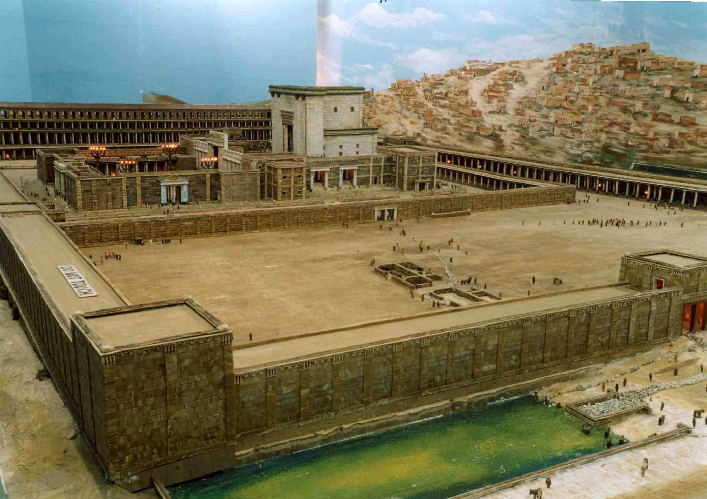
The temple of Herod the Great King of the Jews

Slide 45
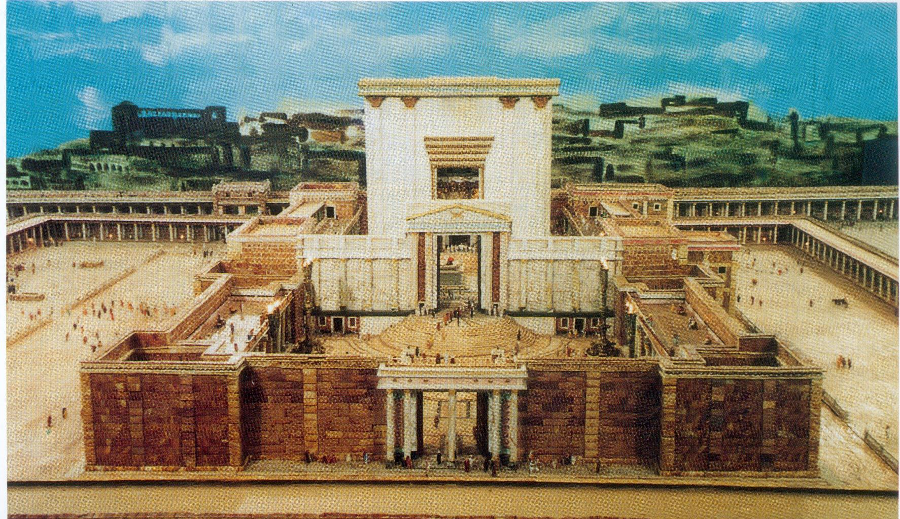
The temple of Herod the Great King of the Jews

Slide 46
Summary of the history
Judea ruled by the Persian Empire 536 BC – 330 BC
Judea ruled by the Alexandrian Empire: 330 BC — 308 BC
Judea ruled by Egypt: 308 BC — 195 BC
Judea ruled by Syria: 195 BC — 130 BC
Judea and the Maccabean Revolt: 164 BC — 63 BC
Judea ruled by the Roman Empire: 65 BC — AD 70
Herod the Great reigns as King of the Jews: 37 BC — 4 BC

Slide 47
The Remnant and Judaism
Now from the history of empires we trace the developments in Judaism
Most Jews do not return! They remain in the lands of captivity, Assyria and Babylonia.
It is safe to assume that those who return with Zerubabbel and Ezra are the most devout.
They are hardly a nation anymore but something else springs up and that something is Judaism
And that Judaism continues until today

Slide 48
The Remnant and Judaism
How to account for such a fundamental change?
The Children of Israel became a nation first in Egypt where they worshipped the Golden Calf which they returned to at Sinai
No sooner were they settled in Canaan than they began to flirt with the Gods of the Canaanites and their detestable practices; Baal, Ashteroth, Milcom, Chemosh and Molech,
By the end; ‘For your gods have become as many as your cities, O Judah, and as many as the streets of Jerusalem are the altars you have set up to shame, altars to make offerings to Baal.’ Jeremiah 11:13 (ESV)

Slide 49
The Remnant and Judaism
Then Judah went into Babylon; hardly the place to cure them of inveterate idolatry.
But they left Babylon cured!
They came out as the most monotheistic people in the world. The custodians and witnesses to the belief in the one true God Jehovah.
To them we all owe a huge debt.
How did it come about?

Slide 50
The Remnant and Judaism
In their extreme situation, when they have lost everything there are still enough of them educated in their scriptures to witness a miracle
And that miracle was their Bible
As they turned to it in bewilderment and perhaps desperation they found something wonderful
Everything that was happening to them was already written in their scriptures

Slide 51
The Remnant and Judaism
The destruction of Jerusalem, the exile of the sons and daughters of Judah to Babylon
The overthrow of Babylon and the brilliant career of Cyrus king of Persia
His edict to rebuild the temple; all this foretold 200 years before it happened; foretold in astonishing detail in Isaiah chapters 43-48
Later still, in Jeremiah 25, 50 and 51 the very limit of their captivity of 70 years is prophesied and Daniel reads it in Babylon in Daniel 9:2

Slide 52
The Remnant and Judaism
Their God is not a god of the imagination of men; he is the only God the ONE God
He tells the end from the beginning
Remember the former things of old; for I am God, and there is no other; I am God, and there is none like me, declaring the end from the beginning and from ancient times things not yet done, saying, ‘My counsel shall stand, and I will accomplish all my purpose,’ Isaiah 46:9–10 (ESV)

Slide 53
The Remnant and Judaism
Even as Cyrus of Persia was conquering their oppressor Babylon they could sit in captivity and read a 200 year old text
Who says of Cyrus, ‘He is my shepherd, and he shall fulfill all my purpose’; saying of Jerusalem, ‘She shall be built,’ and of the temple, ‘Your foundation shall be laid.’ Thus says the LORD to his anointed, to Cyrus, whose right hand I have grasped, to subdue nations before him and to loose the belts of kings, to open doors before him that gates may not be closed: Isaiah 44:28–45:1 (ESV)

Slide 54
The Remnant and Judaism
In Isaiah 44 there is the most devastating passage in all literature against idolatry, Can we say reverently that God through Isaiah is scathing and relentless in his assessment of the stupidity of idol worship
A man cuts down a tree; He makes a fire with it; He cooks a roast dinner on it; He warms himself in by it; And with the leftover firewood he carves a god and holds it in his hand; Is he so stupid that he never questions what he is doing?
He feeds on ashes; a deluded heart has led him astray, and he cannot deliver himself or say, “Is there not a lie in my right hand?” Isaiah 44:20 (ESV)

Slide 55
The Remnant and Judaism
In captivity reading their precious Scriptures it dawned upon a people that their God was unique because He was real. All other gods were illusions
When they returned they would be faced with another plethora of gods, another pantheon of Greek then Roman gods, but by now they were cured of false gods and impervious to the foolishness of them
What a debt the world owes to this exiled people!
But now that they had rediscovered their scriptures how can they ensure that they will never lose them again?

Slide 56
The rise of Jewish Institutions
When we consider the growth and development of the Jewish institutions, with which we are familiar in the New Testament, we must bear in mind their beginnings in the exile
Later Jewish teachers would claim a connection for the synagogue or Sanhedrin going back to the time of Moses but this is almost certainly not the case
They developed during the exile or after the return of the remnant

Slide 57
The synagogue
If we consider the synagogue we can say that not only did it begin during the exile but it was still developing in New Testament times.
After the destruction of the Temple (AD 70) and the destruction of Jerusalem following the Bar Kokhba revolt (AD 132-135), the Jewish people were scattered and sold into slavery. In the absence of their Temple the synagogue became their primary focal point and it is so until today.

Slide 58
The synagogue
In Babylon, a chastened people longed for home ‘By the waters of Babylon, there we sat down and wept, when we remembered Zion. On the willows there we hung up our lyres. Psalm 137:1–2 (ESV)
But they had their scriptures, and able teachers, whether Prophet or priest and they had a desire to come together for prayer and the worship of God
Even after they returned from exile and eventually rebuilt their Temple there as still a place for their regular instruction in the law

Slide 59
The synagogue
They would travel to the Temple for festivals, feasts and offerings but they now had an educational system for the study of the scriptures
Gradually reading became translation and translation became commentary and application and so every Jew was schooled in the scriptures
Elements of the worship included the shema
Sh'ma Yisra'eil Adonai Eloheinu Adonai echad.
Hear, Israel, the Lord is our God, the Lord is One.

Slide 60
The synagogue
The shema was followed by prayers, the reading of the Law and the Prophets together with the necessary translation and an exposition of the passage by some qualified person
The scribes were the teachers in the tradition of Ezra and especially as the priests moved further away from the faith.
The elders or rulers of the synagogue became the model government for the Church

Slide 61
The synagogue
The synagogue also functioned as the missionary outposts of Judaism and by the time of the New Testament there were many Gentile ‘God-fearers’ who had not fully become Jews but were schooled in the Scriptures and Christianity spread among them like wildfire ( See the example of Cornelius in Acts 10)
By New Testament times the synagogue and the Temple had entirely different functions. Jews no longer went to the Temple to be taught (although Jesus taught there) they went each Sabbath to their local synagogue.

Slide 62
The Sanhedrin
The ruling figure in Jewish affairs, after the return from exile, was always the High Priest. So much so that the office was much sought after.
Judaism had always had a tradition of the rule of elders within each tribe and Moses had appointed seventy elders from the tribes to help him rule.
It is therefore unsurprising that this council is retained after exile and it is in full operation in the New Testament

Slide 63
The Sanhedrin
Foreign rulers found the Jewish ‘civil service’ useful and most allowed them a degree of autonomy
After all only a Jewish council could possibly understand the intricate details of their legal system
Headed by the High Priest the Sanhedrin comprised seventy members drawn from the ranks of Jewish aristocracy, the priests, the elders and the doctors of the Law-the scribes
Their authority did not stray into the realms of Roman Law. They could not order the death penalty

Slide 64
The rise of Jewish Parties and Sects
Our chief source for the history of the Jews is a historian named Josephus or Yosef ben Matityahu born in AD 37
He records four parties which he refers to as sects;
Pharisees
Sadducees
Essenes
And Zealots

Slide 65
The Pharisees
Josephus is keen to point out that the Zealots are not to be considered on a par with the other three
The Zealots were, in the eyes of Josephus, little more than bandits one of them was a disciple of Jesus Simon the Zealot (Acts 1:13, Luke 6:15)
The Pharisees were , by far the most influential group and had their origins in the Hasidim of the Maccabean period
They were ‘separatists’ although what they were separating themselves from is not clear

Slide 66
The Pharisees
The pharisees were not priests but laymenwho banded themselves together into brotherhoods for the strict observance of the Law
Captivity had taught them that a disregard for the law had cost them their land and they determined that the nation would never disregard it again
They were assisted by the schools of scribes and doctors of the law and between them there arose the ’oral law’ so powerful in the time of Jesus

Slide 67
The Sadduccees
Whereas the Pharisees were most influential in the synagogues the Sadducees were entrenched in the Temple and everything to do with it
The Sadducees controlled the Sanhedrin along with the aristocratic priests and their influence on Judaism was to wain with the destruction of the Temple whereas the Pharisees continue to flourish even as the Jews were scattered abroad

Slide 68
The Essenes
This was a large influential group but they are not mentioned directly in Scripture
In 1946 their library was discovered in a cave on the shore of the Dead Sea
Here were scrolls of all of the Old Testament apart from Esther and they were 900 years older than the earliest OT manuscripts in the Church libraries
They were the ‘monks’ of Judaism living simple monastic lives

Slide 69
Summary of Judaism at the start of the N T
In addition to these main groups the New Testament mentions the Herodians who, as their name implies were a political party representing the interests of the vassal king Herod
Unsurprisingly this mixture of holier-than-thou Pharisees, politically well-connected Sadducees, firebrand revolutionary Zealots, legally trained Scribes and treacherous Herodians had little in common
But they were all to agree in their opposition to Christ

Slide 70
Summary of Judaism at the start of the N T
One final thought
Just as the Jews had turned to their Scripture in Babylon so a number of them turned again in the days before the New Testament
Daniel had prophesied the coming of Messiah dating it from the command to restore Jerusalem. And the time was up
There had been no prophetic voice for 400 years then came a man dressed as Elijah proclaiming, “Prepare ye the way of the Lord”

