Slide 1
Lesson seven
Survey of the New Testament
Part 2: The Acts of the Apostles
Mountjoy bible school
Weymouth class of 2019

Slide 2
The Acts of the Apostles
Analyse by People
Analyse by Places
Analyse by Principles

Slide 3
Analyse by People
Acts dominated by 2 people
Peter (Chapters 1 to 12)
Paul (13 to 28)
  Both Jews
  Both followers of the Messiah
  Both ministering brethren & fine preachers
  Both workers of miracles, even raising the dead
  Both suffered for Christ even to martyrdom

Slide 4
Analyse by People
Yet there are differences:
Peter accompanied the Lord in His ministry - Paul did not
Peter received his teaching from the lips of the Lord, Paul received his by revelation
Peter, a fisherman, was less versed in the Hebrew Scriptures, whereas Paul was a Rabbi and well versed.

Slide 5
Analyse by People
Peter was at his best in the company of his brethren, Paul did his best work, either in a small team or on his own.
Peter did his best work in Jerusalem, as you would expect – he was the apostle to the Jews.
Paul did his best work away from Jerusalem, as you would expect – he was apostle to the Gentiles
There was rivalry between their followers, but the truth is dual leadership - they are complementary not in competition.

Slide 6
Analyse by People
Peter represents a traditional ministry with a direct connection to Messiah -historical - Jerusalem centred
Paul represents a ministry received by revelation - experience - taking it far and wide (represented by Rome at the end of Acts)
Note : they must be kept in balance

Slide 7
Analyse by People
Nowadays there are church groups and assemblies struggling with the balance.
There are those that are very aware of tradition, and do not want to change anything.
There are those who say, if we do not change we will die. We have to embrace new methods.
The truth is balance. Keep the best of our history – the Christ-centred breaking of bread, but be prepared to receive new guidance also.

Slide 8
Analyse by Places

Slide 9
Analyse by places
Jerusalem
1 to 7
From Local
Judea and Samaria
8 to 12
Uttermost
13 to 28
To Universal

Slide 10
Analyse by places
A comparison of the beginning of the book with the end is informative
The focus of the book moves from Jerusalem (the capital of the Jewish world) to Rome (at that time the capital of the Gentile world)
From the many (Peter plus the eleven plus other disciples) - to the few (Paul on his own but receiving visitors)

Slide 11
Analyse by places
From being free but tied to the City (“tarry in Jerusalem”) - to being in prison yet free in the Spirit (sending the gospel to all corners of the Roman empire).
From not yet empowered (“wait for the promise of the Father”) - to great authority (“Paul, an apostle of Jesus Christ, by the will of God” (Col. 1.1))

Slide 12
Analyse by places
From Jewish emphasis - to Jewish/Gentile emphasis
From local - to universal
The gospel has expanded
  geographically (from Jerusalem to Rome)
  culturally (from Jewish to Jewish/Gentile)

Slide 13
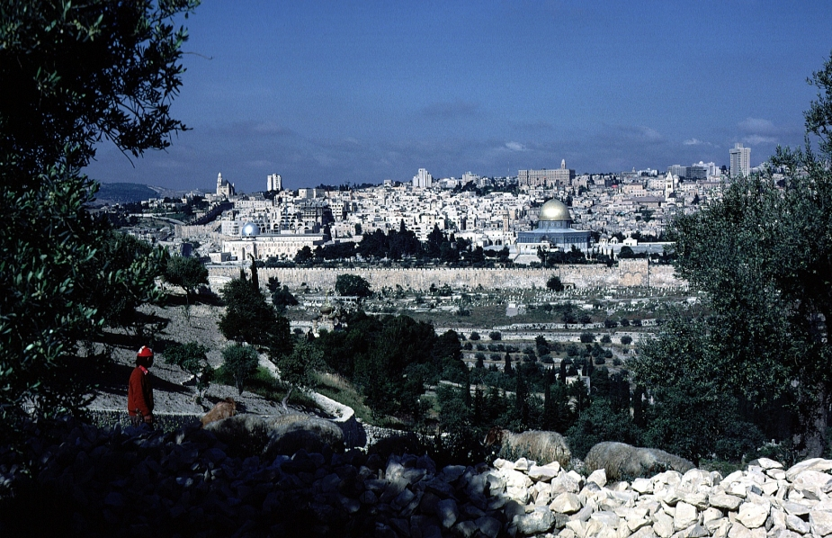
Let us consider
JERUSALEM

Slide 14
Jerusalem
Jerusalem (Chapters 1 – 7)
  Jerusalem is the city of God
  There Jesus walked and ministered
  There He was crucified
  From there He ascended (Acts 1.9)
  To there He will return (Acts 1.11)
  It was there the disciples were gathered when the Holy Spirit began His new work as Baptiser, Paraclete, Comforter, Indweller and Advocate.

Slide 15
Jerusalem
WHEN THE DAY OF PENTECOST
HAD FULLY COME

Slide 16
Jerusalem
Luke’s inspired phrasing intimates that this particular feast day was the full realization of what the Feast of Weeks was intended to indicate.
The Feast had ‘fully come’, ending one period in God’s purposes and beginning another.

Slide 17
Jerusalem
The main elements of the day were:
The descent of the Spirit of God
The baptism of Messianic believers into the body of Christ.
The end of the dispensation of Law.
The beginning of the dispensation of Grace.
The commencement of the dispensation of the New Covenant.
A reversal of the Tower of Babel judgment.
The firstfruits of a harvest of souls.

Slide 18
Jerusalem
The feast of weeks (or Pentecost) was a harvest festival (the firstfruits of the wheat harvest)
They read the book of Ruth
It was also a celebration of the giving of the Law (Sivan 6 is identified in the Talmud as the anniversary of the giving of the law to Moses on Sinai)
So they also read Exodus chapters 19 & 20

Slide 19
Jerusalem
Because the appearance of God to Moses was a theophany they took extra readings they took extra readings from Ezekiel (1 & 2) and Habakkuk (3))
Shavuot (The Hebrew name for the Feast) was also the traditional date of David’s death.

Slide 20
Jerusalem
All these features are important inasmuch as the inauguration of the New Covenant has much in common with the inauguration of the Mosaic covenant.
Here is another theophany by fire.
The Spirit of God descended and divided as tongues of fire and rested on the believing saints.
Fire indicates the presence of God (cf. Moses at the bush, Ezekiel’s vision, etc)

Slide 21
Jerusalem
The theophany by fire at the bush and on the mountain indicated the birth of the nation, and the commencement of the dispensation of Law.
The theophany by fire in Jerusalem indicated the birth of the new ekklesia and the commencement of the dispensation of Grace.

Slide 22
Jerusalem
Peter identifies this descent of the Spirit as a fulfilment of Joel’s prophecy.
  ‘And it shall come to pass in the last days, says God, That I will pour out of My Spirit on all flesh; Your sons and your daughters shall prophesy, Your young men shall see visions, Your old men shall dream dreams. And on My menservants and on My maidservants I will pour out My Spirit in those days; And they shall prophesy.’ ‘(Ac 2:16-18)

Slide 23
Jerusalem
This use of Joel’s prophecy by Peter indicates the work of the Spirit that is later explained by Paul.
  “For by one Spirit we were all baptized into one body—and have all been made to drink into one Spirit.” (1 Cor. 12:13)
  It is the fulfilment of the promise of the Messiah who said the Spirit “will be in you”. (John 14:17)

Slide 24
Jerusalem
This inauguration of the New Covenant was also the fulfilment of the prophecy of Jeremiah, and the words of Jesus.
  and indicates the internalising of that which under the Law was external.
  “I will put My law in their minds, and write it on their hearts; and I will be their God, and they shall be My people.” (Jer. 31:33)

Slide 25
Jerusalem
And we must not overlook the gift of language that also took place on the day of Pentecost.
This was reversal of the judgement of Babel.
There they were united in rebellion against God and God confounded their language.
Here they are united in praise of God and God grants that they should hear these praises in their own language.

Slide 26
Jerusalem
It was also the anniversary of the death of David and Peter uses this fact in his Pentecostal sermon.
He says that David is dead, his throne is empty and his tomb is occupied, as everyone is aware. (Acts 2.29)
But the Son of David, who was crucified - His tomb is empty and His throne is occupied. (Acts 2.31-36)

Slide 27
Jerusalem
Peter’s sermon bore much fruit. At this harvest festival, there was a mighty harvest, and 3,000 souls were saved.
Indeed the days that followed showed the Messianic community increasing in size.
All the early converts were Jews. (The crowds were Jews of Jerusalem and Jewish pilgrims up for the feast)

Slide 28
Jerusalem
But the plan of God is , ‘Go ye into all the world, and preach the gospel to every creature’
Therefore the church at Jerusalem needs educating.
There arose a persecution, and then …...

Slide 29

To Jerusalem is added
JUDEA and SAMARIA

Slide 30
Judea and Samaria
The Samaritans are the first to be evangelised (by Philip, then by Peter and John)
Then there are recorded 3 conversions which demonstrate the movement of Acts.
First the Ethiopian Eunuch (Chapter 8)
Then Saul of Tarsus (Chapter 9)
Then Cornelius (Chapter 10)

Slide 31
Judea and Samaria
The Ethiopian is a son of Ham
Saul is a son of Shem
Cornelius is a son of Japheth
Therefore being drawn from the sons of Noah they represent ‘the whosoever’
The Ethiopian is a Jewish proselyte
Saul is an Hebrew of the Hebrews (Jew)
Cornelius is a Roman centurion (Gentile)

Slide 32
Judea and Samaria
The emphases are
The word of God (Ethiopian) - ‘faith cometh by hearing, and hearing by the Word of God)
The Christ of God (Saul) - ‘believe on the Lord Jesus Christ and thou shalt be saved’
The Spirit of God (Cornelius) - ‘no man can say that Jesus is the Lord, but by the Holy Spirit’.

Slide 33
Judea and Samaria
The work of Christ is also emphasised :
With the Ethiopian –
  it is Christ crucified (Isaiah 53)
With Saul of Tarsus –
  it is Christ resurrected (I am Jesus)
With Cornelius -
  It is Christ ascended (the gift of the Holy Spirit … poured out). Ac 10:45

Slide 34
The transition summarised
Chapter 8 | Chapter 9 | Chapter 10
ETHIOPIAN | SAUL | CORNELIUS
HAM | SHEM | JAPHETH
JEWISH PROSELYTE | JEW FOR THE GENTILES | GENTILE
WORD OF GOD | CHRIST OF GOD | SPIRIT OF GOD
CHRIST CRUCIFIED | CHRIST RESURRECTED | CHRIST ASCENDED

Slide 35
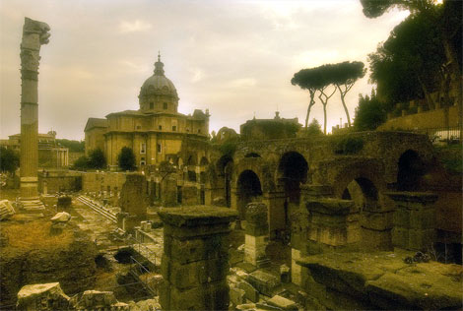
From Jerusalem and Samaria the gospel moves to the uttermost parts; well to Rome actually
ROME

Slide 36
To the Uttermost Parts
Separate me Barnabas and Saul for the work whereunto I have called them.(Acts 13.2)
Paul, and Barnabas, and Silas, and Mark, and Timothy
Paul the pioneer, aiming for Rome, ‘oftentimes I purposed to come to you..’ becomes Paul the prisoner and gets there.

Slide 37
Analyse by Principles

Slide 38
The Holy Spirit at Work
1 to 5
In the local community
21 to 28
In a crisis
6 to 12
In individual lives
13 to 20
In groups or teams

Slide 39
Ministry of the Spirit in a Local Community (1 to 5)
They had Unity
  ... all with one accord in one place (2.1)
  ... all that believed were together, and had all things common (2.44)
  Behold, how good and how pleasant it is for brethren to dwell together in unity (Ps.133.1)
  Be likeminded, having the same love, being of one accord, of one mind (Phil, 2.2)
  Endeavouring to keep the unity of the Spirit in the bond of peace (Eph.4.3)

Slide 40
Ministry of the Spirit in a Local Community (1 to 5)
They had Authority
  In Preaching
    ..let all the house of Israel know assuredly, that God hath made that same Jesus, whom ye have crucified, both Lord and Christ (2.36)

Slide 41
Ministry of the Spirit in a Local Community (1 to 5)
Authority
  In actions
    Silver and gold have I none; but such as I have give I thee: In the name of Jesus Christ of Nazareth rise up and walk (3.6,7)
    Dealing with the sin of Ananias & Sapphira
    The fear of the Lord - No-one dared join them

Slide 42
Ministry of the Spirit in a Local Community (1 to 5)
They had Spontaneity (Freedom of the Spirit)
  Things are not planned
    The miracle outside the Temple
    The impromptu message
    ‘And daily in the temple, and in every house, they ceased not to teach and preach Jesus Christ’.

Slide 43
Ministry of the Spirit in individual lives (7 to 12)
From Community we move to individuals and consider individual Gift
Stephen
  ‘And Stephen, full of faith and power, did great wonders and miracles among the people’ (6.8)
Philip (Samaria in 8; Ethiopian in 9)
Ananias (Commissioning Saul of Tarsus)
Peter (Preaching to Cornelius - the keys)

Slide 44
Ministry of the Spirit in individual lives (7 to 12)
Individual gift is also to support the Christian community
  ‘And he gave some, apostles; and some, prophets; and some, evangelists; and some, pastors and teachers’ (Eph.4.11)
  It keeps the balance between corporate and individual (Section 1 and Section 2)

Slide 45
Ministry of the Spirit in individual lives (7 to 12)
This section not only deals with individual gift but also individual guidance.
Guidance can be through circumstances – e.g. persecution – this sent Philip to Samaria
Guidance can be by a word from God
  Philip was sent to Gaza, ‘And the angel of the Lord spake unto Philip, saying, Arise, and go toward the south unto the way that goeth down from Jerusalem unto Gaza, which is desert’.
  Ananias was sent to a street called Straight, ‘and to him said the Lord in a vision, Ananias …’

Slide 46
Ministry of the Spirit in groups or teams (13 to 20)
Some activities of God requires teamwork.
Barnabas & Saul (withMark)
  ‘Separate me Barnabas and Saul for the work whereunto I have called them’ (13.1)
  Gift and guidance still important but in addition ……. Leadership
  Starts ‘Barnabas and Saul’ but soon on isle of Cyprus - Paul and his company
Paul & Silas (with Timothy)

Slide 47
Ministry of the Spirit in groups or teams (13 to 20)
In small teams loyalty is important
  If a team is necessary for the success of the gospel then Satan will seek to ‘separate intimate friends’. (Pr.17.9 (NASB))
  ‘Two are better than one; .... For if they fall, the one will lift up his fellow: but woe to him that is alone when he falleth; for he hath not another to help him up. ... And if one prevail against him, two shall withstand him; and a threefold cord is not quickly broken’. (Eccl. 4.9-12)

Slide 48
Ministry of the Spirit in groups or teams (13 to 20)
To Loyalty we must add Harmony
  Different Gifts (A Paul is different to a Barnabus) yet complementary
  If ‘gift’ then the possessor cannot boast, and the other cannot be jealous

Slide 49
Ministry of the Spirit in a crisis (21 to 28)
The book of Acts also shows the experience of a man in a crisis. In such a situation can He trust in God to help?
Paul is accused, examined, tried, appeals to Caesar and sent to Rome.
But though he is physically a prisoner yet spiritually he is free.
From Rome his message wings its way to many corners of the Empire.
And some visitors, like Onesimus, find salvation in his company.

Slide 50
Ministry of the Spirit in a crisis (21 to 28)
As a prisoner he has to defend himself before Caesar.
But he also intimates that he has to defend himself against ‘false brethren’.
He has to defend his apostleship and he has to defend the gospel he preaches.
  “I am set for the defence of the gospel”, he wrote. (Phil.1.17)

Slide 51
Ministry of the Spirit in a crisis (21 to 28)
Paul had to take a stand but what principles did he go to the barricades for?
  (i) He stood for the purity of the gospel.
    Not two gospels; one for Jews; one for Gentiles
    He maintained the death of the Lord Jesus was sufficient
    Not His death plus …. Law of Moses or good works, etc.
    ‘But though we, or an angel from heaven, preach any other gospel unto you than that which we have preached unto you, let him be accursed’ (Gal.1.8)

Slide 52
Ministry of the Spirit in a crisis (21 to 28)
(ii) He stood for the Unity of the Church
Not two churches, one for Jews, one for Gentiles
  ‘Is Christ divided?’ - answer ‘No’
  ‘For as the body is one, and hath many members, and all the members of that one body, being many, are one body: so also is Christ. For by one Spirit are we all baptized into one body, whether we be Jews or Gentiles’ (1 Cor.12.12,13)
  ‘For ye are all one in Christ Jesus’ (Gal.3.28)

Slide 53
Ministry of the Spirit in a crisis (21 to 28)
This last section tells of no new converts, or churches, yet how fruitful.
Letters to
  the Philippians,
  the Colossians,
  the Ephesians &
  Philemon

Slide 54
The Book of Acts - Summary
The Book can be divided into
Two and analysed by people, that is the major characters, Peter and Paul
Three following the geographical expansion of the gospel, Jerusalem, Judea & Samaria, the uttermost parts
Four (the different ministries of the Spirit; in a local church; in individual lives; in teams, and in a crisis)

Slide 55
The Holy Spirit at Work
1 to 5
In a local church
Unity
Authority
Spontaneity
6 to 12
In Individual lives
Gift
Guidance
13 to 20
In Teams
Leadership
Harmony
Loyalty
21 to 28
In a Crisis
Purity of the Gospel
Unity of the Church

Slide 56
The Book of Acts
The order is important
First we find our place in the local church
Then develop our individual gift and obtain our guidance
Then engage in Christian work with others
Always knowing that if we are called to stand alone, the Lord will stand with us

Slide 57
GO YE THEREFORE INTO ALL THE WORLD AND PREACH THE GOSPEL

