Slide 1

Spring term 2020
Lesson Seven
Epistle of Paul to the Romans
Mountjoy bible school
Weymouth class of 2019
Spring term 2020

Slide 2

The Outline of the Book
Chapters 1-8 Doctrinal
How the Gospel saves the sinner
Chapters 9-11 National
How the gospel relates to Israel
Chapters 12-16 Practical
How the gospel relates to conduct

Slide 3

The Outline of Chapters 1-8
Again we can start at the end for chapter eight
is the great culmination of the presentation
We cannot be in any doubt concerning the
subject of chapter eight since the Holy Spirit is
mentioned nineteen times whereas He has only
been mentioned once in all the earlier chapters
We are heading therefore to a grand
conclusion; the life of the Christian lived by the
power of the indwelling Spirit of God

Slide 4
The Outline of Chapters 1-8
Following a prologue which occupies the first
seventeen verses the Apostle then shows man’s
desperate need for the Gospel
This is divided into two parts; The need for the Gospel
among the Gentiles 1:18-32
Then the equal need for the Gospel among the Jews
2:1-3:20
Both the Jew and the Gentile have ‘sinned’ but both of
them are also in a condition of ‘sin’. This is an important
distinction and the gospel deals with both aspects

Slide 5

The Outline of Chapters 1-8
How the Gospel deals with our ‘Sins’ is the
subject of chapters 3:21-5:11
How the gospel deals with our ‘Sin’ is the
subject of chapters 5:12-8:39
We can summarise this with two great
aspects of gospel truth
What Christ has done for us
What Christ is doing in us

Slide 6

The Burden of Chapters 1-8
The exposition of the gospel of Jesus
Christ which brings salvation from sin;
“by grace alone,
through faith alone,
in the blood of Jesus
alone”.

Slide 7

Life by the Holy Spirit Chapter 8:1-11
Therefore, there is now no condemnation for those
who are in Christ Jesus,
2 because through Christ Jesus the law of the Spirit
of life set me free from the law of sin and death.
3 For what the law was powerless to do in that it
was weakened by the sinful nature; God did by
sending his own Son in the likeness of sinful man to
be a sin offering. And so, he condemned sin in sinful
man,

Slide 8
Life by the Holy Spirit Chapter 8:1-11
4 in order that the righteous requirements of the law
might be fully met in us, who do not live according
to the sinful nature but according to the Spirit.
5 Those who live according to the sinful nature
have their minds set on what that nature desires;
but those who live in accordance with the Spirit
have their minds set on what the Spirit desires.
6 The mind of sinful man is death, but the mind
controlled by the Spirit is life and peace;

Slide 9
Life by the Holy Spirit Chapter 8:1-11
7 the sinful mind is hostile to God. It does not submit
to God’s law, nor can it do so.
 8 Those controlled by the sinful nature cannot
please God.
9 You, however, are controlled not by the sinful
nature but by the Spirit, if the Spirit of God lives in
you. And if anyone does not have the Spirit of
Christ, he does not belong to Christ.

Slide 10
Life by the Holy Spirit Chapter 8:1-11
10 But if Christ is in you, your body is dead because
of sin, yet your spirit is alive because of
righteousness.
11 And if the Spirit of him who raised Jesus from the
dead is living in you, he who raised Christ from the
dead will also give life to your mortal bodies
through his Spirit, who lives in you.
From the deep, depressing and dark night of the
soul recorded in the latter part of chapter 7 we
burst suddenly on the glorious sunlight of life
through the Spirit.

Slide 11
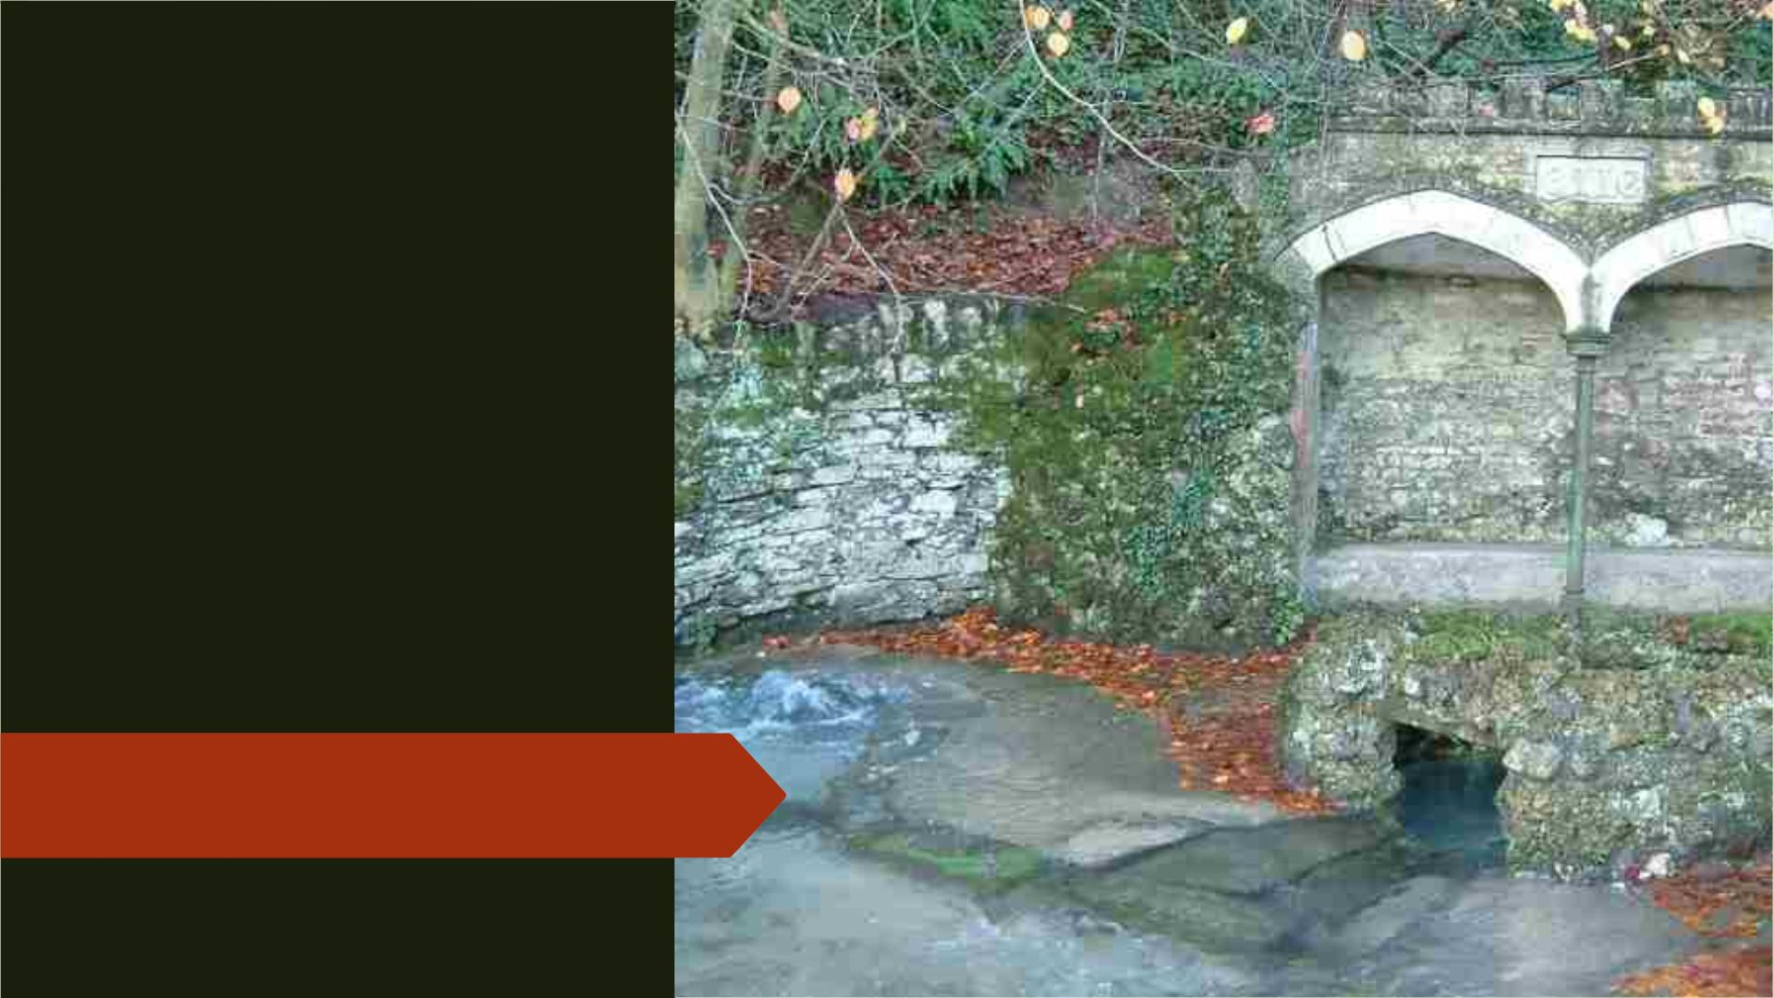
The source of
the river Wey
at Upwey
Wishing Well

Slide 12
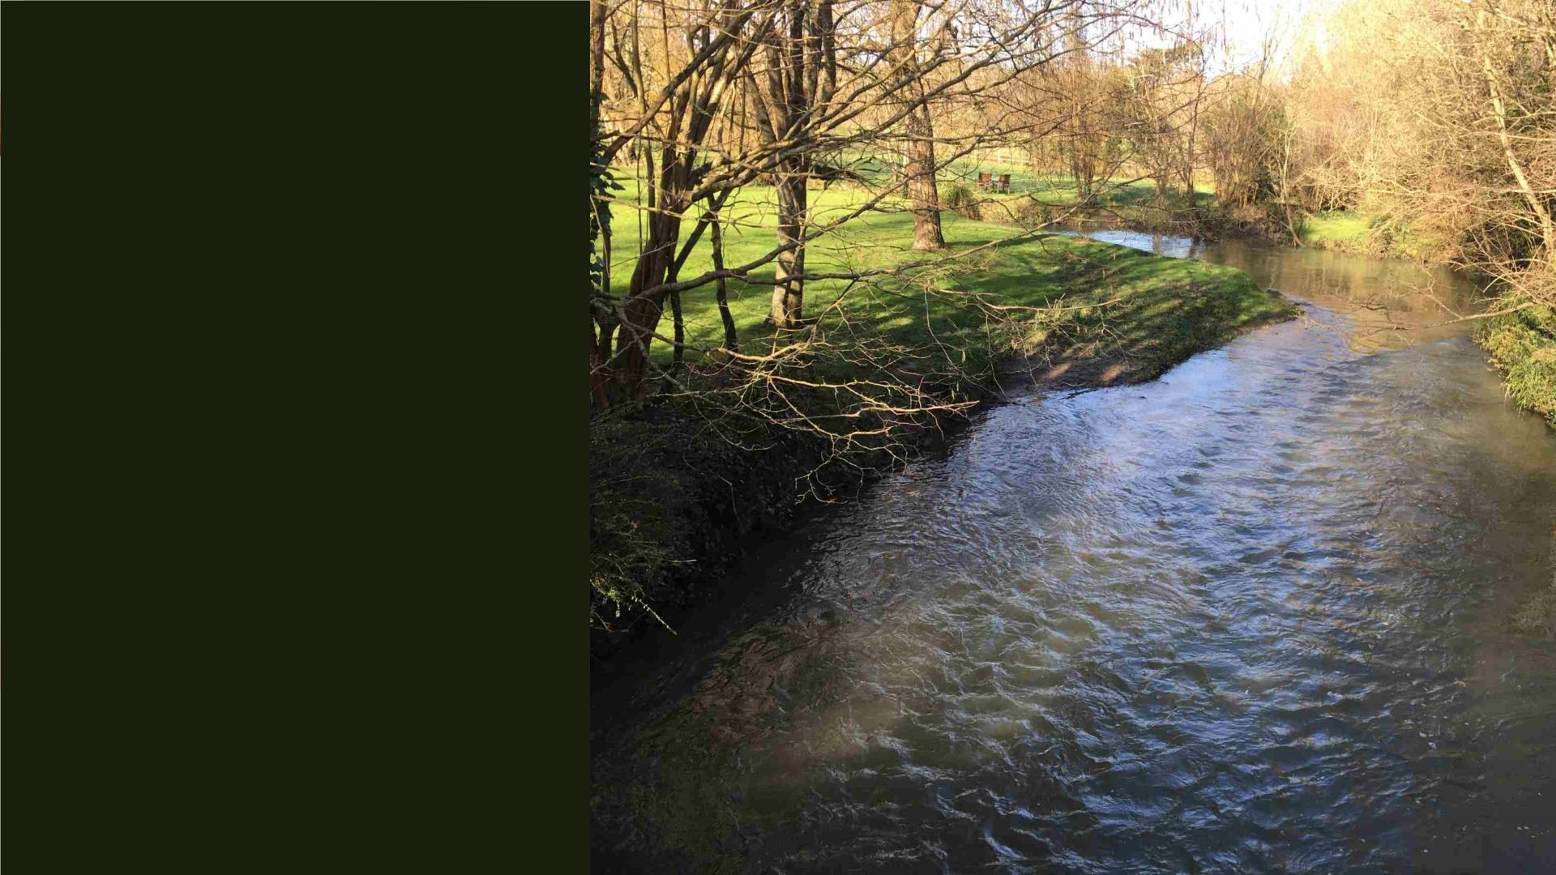
River Wey at
Radipole village
Only 7 miles long
the river falls only
200 ft. but formerly
drove six mills and
supplied the Roman
reservoir at
Radipole Lake

Slide 13
Life by the Holy Spirit Chapter 8:1-11
We

Slide 14
Life by the Holy Spirit Chapter 8:1-11
Straight away we should notice that there is no
separate gospel of the Holy Spirit. Paul is still
expounding the gospel of the Lord Jesus Christ and
this is clear from verse 1.
We are back on familiar ground that there is no
condemnation for them that are in Christ Jesus.
This phrase, “in Christ Jesus” assumes that we have
been awakened to God’s holiness, convinced of
God’s judgement and assured of his love and his
provision in Christ.

Slide 15
Life by the Holy Spirit Chapter 8:1-11
We have heartily trusted in his promise just like
Abraham, and we have been justified, made
righteous, because we took God at his word.
We leave the courtroom totally vindicated for
another has taken our place and paid our debt.
Furthermore, we have seen that we are so united
with our Saviour that we are considered to be “in
him”, in his death and in his resurrection and
ascension.
This is all clear to us and we have voluntarily
surrendered our lives as happy slaves or as his
dearly loved bride.

Slide 16
Life by the Holy Spirit Chapter 8:1-11
There is no more condemnation for us. We were
once controlled by a law of sin, but God has been
at work in our lives through the Holy Spirit,
awakening us to our condition, showing us the Lord
Jesus, bringing repentance and faith as we trusted.
Giving us new life by placing us into Christ and
setting us free by his indwelling power.
We have been willingly cooperating with him in this
process, seeing what he wanted us to see,
believing in what he revealed to us, trusting with all
our hearts and surrendering our lives to his control.

Slide 17
Life by the Holy Spirit Chapter 8:1-11
Up until chapter 3 the epistle dealt with the Law
aspect of our salvation.
In chapters 4-6 we have seen in the mighty
provision of Jesus the Love aspect of our salvation.
Now we are concerned through chapters 7-8 with
the Life aspect of our salvation.
How can we please God? Only as we are
controlled by the Holy Spirit.

Slide 18
Life by the Holy Spirit Chapter 8:1-11
We

Slide 19
Life by the Holy Spirit Chapter 8:1-11
We

Slide 20
Life by the Holy Spirit Chapter 8:1-11
We

Slide 21
Life by the Holy Spirit Chapter 8:1-11
We

